Slide 1
Informatica PowerCenter
Lesson 2 : PowerCenter Designer

Slide 2
Lesson Objectives
In this lesson you will learn about:
  Concept of a Mapping
  PowerCenter Designer : Modes
  Analyze Sources
  Creating a Target Schema
  Mapping Designer
  Transformation Overview
  Source Qualifier Transformation
  Expression Transformation
  Aggregator Transformation

Slide 3
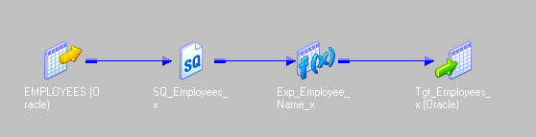
2.1: Mapping
Concept
Mappings depict the flow of data from source to target
Integration service uses these instructions to read, transform, and write data
Designer provides set of transformations to build mappings
Figure 2.1
Notes:
When the Integration service loads data, it uses the instructions configured, to read, transform, and write data.

Slide 4
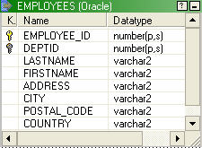
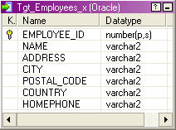


2.1: Mapping
The Design Process
Create Repository
Import Source Definitions
Create Target Schema
Create Mappings
Load Data into Target
Repository
Mapping
Source
Database
Target
Database
Figure 2.2
Notes:
Create Repository - The first step is to create the Informatica repository from the Repository Server Administration Console. This repository will hold all related metadata and drive Informatica’s extraction and transformation process. Once the repository and necessary folders have been created, the actual design process can begin. This is accomplished in the Designer client application, where developers will spend the majority of their time.
Import Source Definitions - The next step will be to put the source definitions into the repository. The Source Analyzer within the Designer tool is used for this process
Create Target Schema - After the source definitions are in the repository, the target schema should be created. This can be designed in the Target designer (also with the Designer), reverse engineered from the database, or imported through PowerPlugs
Create Mappings - Mappings can be created to link the sources with the targets – the translation of ‘business rules’
Load Data - The final step is to load the data. The Workflow Manager is used to configure and schedule session Tasks and Workflows to run the mappings. Then, based upon all the information stored in the repository, the Integration service will extract, transform, and load the data

Slide 5
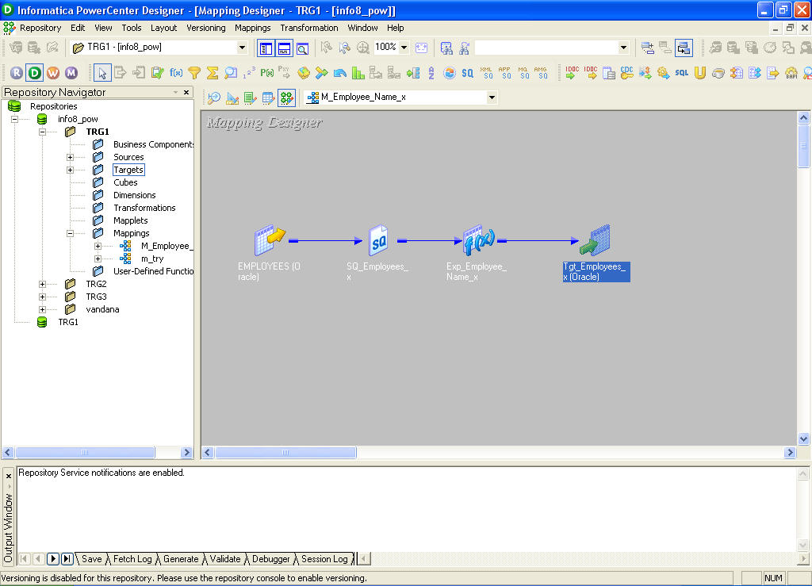
2.2: PowerCenter Designer Workspace
Concept
Open Folder List
Workspace
Navigator Window
Output Window
Status bar
Figure 2.3
Notes:
The PowerCenter Designer has five tools which helps to build mappings and mapplets so that one can specify how to move and transform data between sources and targets. The Designer helps to create source definitions, target definitions, and transformations to build the mappings.
The Designer consists of the following :
Navigator window - Use to connect to and work in multiple repositories and folders. Copy and delete objects options are available and shortcuts can be created using the Navigator
Workspace window- Use to view or edit sources, targets, mapplets, transformations, and mappings. Work with a single tool at a time in the workspace. One can use the workspace in default or workbook format
Status bar - Displays the status of the operation being performed
Output window- Provides details while performing certain Tasks, such as saving the work or validating a mapping. Right-click the Output window to access window options, such as printing output text, saving text to file, and changing the font size

Slide 6
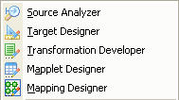
2.2: PowerCenter Designer Workspace
Modes
The Informatica PowerCenter Designer has five modes:
Source Analyzer
Target designer
Transformation Developer
Mapplet Designer
Mapping Designer
Figure 2.4
Notes:
The Informatica Designer has five modes:
The Source Analyzer is used to create or reverse-engineer source definitions
The Target designer is used to create or reverse-engineer target schema
The Transformation Developer is used to create reusable transformations
The Mapplet Designer is used to create and edit mapplets. Mapplets are reusable objects that represent a set of transformations
The Mapping Designer can be used to create the source to target mappings that contain the business rules for the server during the extract, transform, and load process

Slide 7
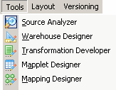
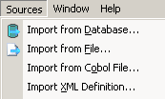
2.3: Analyze Sources
Introduction
The Source Analyzer tool is used to define Source Definitions
Source Definitions describe the sources that are going to be providing data to the warehouse
Source Definitions can be imported from Database, Flat Files, COBOL files and XML files or can be defined manually
Figure 2.5
Notes:
The first tool, the Source Analyzer, is used to identify the sources that will be used to build the data mart or warehouse and create repository definitions for those sources. Source definitions describe the sources that are going to be providing data to the warehouse. The different ways to create source definitions in the Repository.
Import from Database
Import from File
Import from COBOL File
Import from XML…
Create manually
Import from SAP
Import from PeopleSoft
Import from Siebel

Slide 8
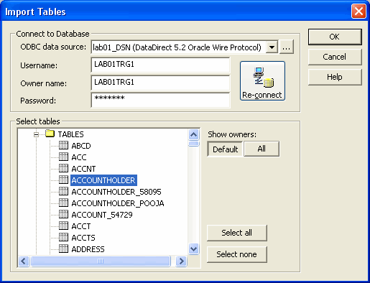
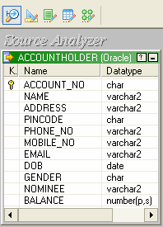

2.3: Analyze Sources
Creating A Source Definition
To import the source definition from a database table the following details are required:
  An ODBC connection using the Data Direct Driver for the database
  Username and Password to connect to the appropriate database
Figure 2.6
Notes:
Relational source definitions can be imported from database tables, views, and synonyms. When importing a source definition, import the following source metadata:
Source name
Database location
Column names
Datatypes
Key constraints
To import a source definition, first connect to the source database from the client machine using a properly configured ODBC data source or gateway. Read permission is required on the database object.
After importing a relational source definition, optionally enter business names for the table and columns. Also manually define key relationships, which can be logical relationships created in the repository that do not exist in the database.

Slide 9
2.4:Importing a Database Source Definition
Demo
Demo Topic
Notes:
Steps to import a source definition:
In the Source Analyzer, choose Sources | Import from Database.
Select the ODBC data source used to connect to the source database. To create or modify an ODBC data source, click the Browse button to open the ODBC Administrator. Create the appropriate data source and click OK. Select the new ODBC data source.
Enter a database username and password to connect to the database.
Note: The username must have the appropriate database permissions to view the object. The owner name for database objects will have to be specified in order to use them as sources.
Click Connect.
If no table names appear or if the table to be imported does not appear, click All.
Scroll down through the list of sources to find the source to be imported. Select the relational object or objects to be imported. Hold down the Shift key to select a block of sources within one folder, or hold down the Ctrl key to make non-consecutive selections within a folder.
Click OK.

Slide 10
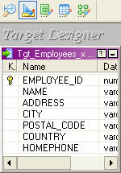
2.4: Creating A Target Schema
Introduction
The Target designer provides a GUI interface for creating and customizing the logical target schema
Target schema can be created in three ways:
  Automatic Creation
  Import from Database
  Manual Creation
Figure 2.7
Notes:
The next step in the design process is to create the target schema. This is accomplished in the second component of the Designer, the Target designer.
The Target designer provides a GUI interface for creating and customizing the logical target schema. Target definitions can be customized as needed.
When the customization is complete, one can create the physical targets in the database from SQL scripts executed from the Target designer.
The methods of creating target schema are:
Automatic Creation
Import from Database
Manual Creation

Slide 11
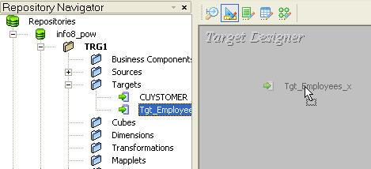
2.4: Creating A Target Schema
Definition
Dragging and dropping a source definition from the Navigator window to the Target designer workspace automatically creates a duplicate of the source definition as a target definition
Drag and drop
Figure 2.8
Notes:
Target definitions are stored in a separate section of the repository.
Automatic target creation is useful for creating:
Staging tables, such as those needed in Dynamic Data Store
Target tables that will mirror much of the source definition
Target tables that will be used to migrate data from different databases, e.g., Sybase to Oracle

Slide 12
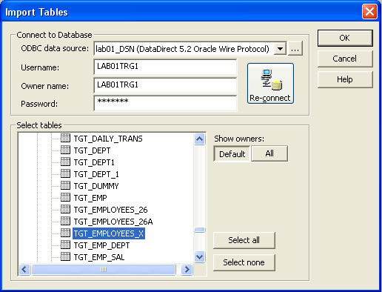

2.4: Creating A Target Schema
Creating A Target Definition
To import the target definition from a database table the following details are required:
An ODBC connection using the Data Direct Driver for the database
Username and Password to connect to the appropriate database
Figure 2.9
Notes:
When a target definition is imported from a relational table, the Designer imports the following target details:
Target name - The name of the target
Database location - Specify the database location of a relational source is to be imported. Specify a different location while editing the target definition in the Target designer and while configuring a session
Column names - The names of the columns
Data types - The Designer imports the native datatype for each column
Key constraints - The constraints in the target definition can be critical, since they may prevent data from moving into the target if the Integration service violates a constraint during a Workflow. For example, if a column contains the NOT NULL constraint and one fail to map data to this column, the Integration service cannot insert new records into the target table
Key Relationships - The Target designer can be customized to automatically create primary-foreign key relationships. Choose Tools | Options and select the Format tab. Check Import Primary and Foreign Keys. Also logical relationships can be created in the repository. Key relationships do not have to exist in the database

Slide 13
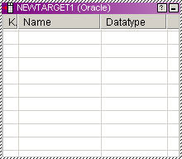
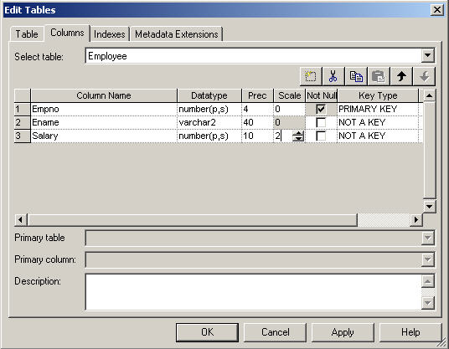
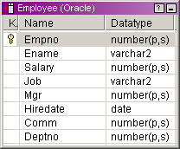
2.4: Creating A Target Schema
Creating A Manual Target
Create empty definition Add desired columns
Finished target definition
Figure 2.10
Notes:
Target Definitions can also be created manually via a menu option or the toolbar. An empty definition is created, you can enter the table name, columns, datatypes, precision, and key information.
Manual target creation is useful for creating tables whose columnar information cannot be copied from source definitions, such as time dimension tables or aggregate tables.

Slide 14
2.4: Creating Target Schema
Demo
Demo Topic
Notes:
Steps to create a Target schema:
I Automatic Target Schema:
Drag a relational source definition into the Target designer workspace, the Designer will create a relational or flat file target definition that matches the source definition.
II From the Database:
To import a relational target definition:
In the Target designer, choose Targets | Import from Database.
Select the ODBC data source used to connect to the target database. To create or modify an ODBC data source first, click the Browse button to open the ODBC Administrator. After creating or modifying the ODBC source, continue with the following steps.
Enter the username and password needed to open a connection to the database, and click Connect. If the user is not the owner of the table to be used as a target, specify the owner name.
Drill down through the list of database objects to view the available tables which can be used as targets.

Slide 15
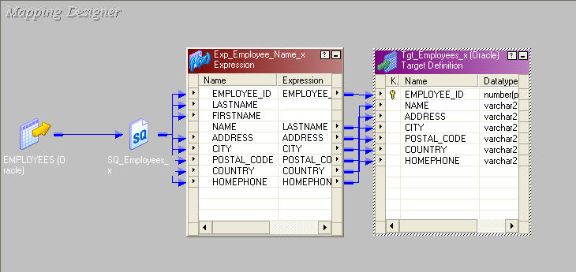
2.5: Mapping Designer
Introduction
Mappings are created in the Mapping Designer
Connectors
Source Definition
(Iconized view)
Transformation
(Normal view)
Target Definition
(Normal view)
Figure 2.11
Notes:
The above diagram shows how a mapping looks like. It has the various transformations which the source data has to go through. Every mapping must contain the following components:
Source definition - Describes the characteristics of a source table or file
Transformation - Modifies data before writing it to targets. Use different transformation objects to perform different functions
Target Definition - Defines the target table or flat file
Connectors - Connect sources, targets, and transformations so the Integration service can move the data as it transforms it
The Mapping Designer displays objects in three different views:
Iconized - Shows an icon of the object with the object name
Normal - Shows the columns in the ports tab and the input and output port indicators. One can connect objects that are in the normal view
Edit - Shows the object properties. Switch between the different tabs and configure the object in this view

Slide 16
2.6: Transformation
Overview
A transformation is a repository object that generates, modifies, or passes data
Transformations in a mapping represent the operations the Integration service performs on the data
Data passes into and out of transformations through ports that are linked in a mapping or mapplet
Ports can be one of the three types:
  Input
    data is received
  Output
    data is provided
  Input / Output
    data passes directly through transformation unchanged
Notes:
The Designer provides a set of transformations that perform specific functions. For example, an Aggregator transformation performs calculations on groups of data. Perform the following Tasks to incorporate a transformation into a mapping:
Create the transformation - Create it in the Mapping Designer as part of a mapping, in the Mapplet Designer as part of a mapplet, or in the Transformation Developer as a reusable transformation
Configure the transformation - Each type of transformation has a unique set of options that can be configured
Link the transformation to other transformations and target definitions - Drag one port to another to link them in the mapping or mapplet

Slide 17
2.6: Transformation
Types
Active
  Changes the number of rows passing through it
Passive
  Number of rows passing through it do not change
Connected
  Connected to the transformations in the data flow
Unconnected
  Not connected to any transformations in the data flow
Notes:
Active - An active transformation can change the number of rows that pass through it, such as a Filter transformation that removes rows that do not meet the filter condition.
Passive - A passive transformation does not change the number of rows that pass through it, such as an Expression transformation that performs a calculation on data and passes all rows through the transformation.
Connected - Connected transformations are connected to the data flow.
Unconnected - An unconnected transformation is not connected to other transformations in the mapping. It is called within another transformation, and returns a value to that transformation.

Slide 18
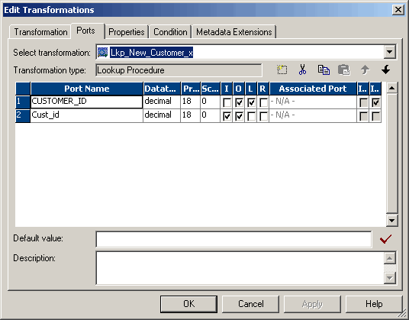
2.6: Transformation
Tabs
Default tabs
  Transformation
  Ports
  Properties
  Metadata Extensions
Additional tabs
  Condition
  Sources
  Normalizer
Transformation tabs
Figure 2.12
Notes:
Each transformation has a minimum of four tabs:
Transformation – allows to rename a transformation, switch between transformations, enter transformation comments, and make a transformation reusable
Ports – allows to specify level attributes such as port name, datatype, precision, scale, primary/foreign keys, nullability
Properties – allows to specify the amount of detail in the session log, and other properties specific to each transformation
Metadata Extensions – allows to extend the data stored in the repository by associating information with individual repository objects
The additional tabs are :
Condition – allows to enter conditions for e.g. Joiner or Filter Transformation
Sources – allows to specify additional source definitions e.g. Source Qualifier Transformation
Normalizer – allows to enter new ports for the Normalizer Transformation

Slide 19
2.6: Transformation
Active and Passive Transformations
Active | Passive
Source Qualifier | Expression
Normalizer | Lookup
Aggregator | Stored Procedures
Filter | Sequence Generator
Router | External Procedure
Rank
Sorter
Update Strategy
Joiner
Notes:
Active Transformations:
Source Qualifier - represents all data queries from the source
Normalizer - normalizes records from VSAM or relational sources
Aggregator - performs aggregate calculations
Filter - serves as a conditional filter
Router - serves as a group conditional filter
Rank - limits records to top or bottom range
Sorter - sorts the input rows in ascending or descending order
Update Strategy - allows for logic to insert, update, delete, or reject data
Joiner – allows extraction of data from heterogeneous sources
Application Source Qualifier - Represents the rows that the Integration Service reads from an application, such as an ERP source, when it runs a session.
Transaction Control - Defines commit and rollback transactions.
XML Generator - Reads data from one or more input ports and outputs XML through a single output port.
XML Parser - Reads XML from one input port and outputs data to one or more output ports.
XML Source Qualifier - Represents the rows that the Integration Service reads from an XML source when it runs a session.

Slide 20
2.6: Transformation
Active and Passive Transformations
Active | Passive
Application Source Qualifier
Transaction Control
XML Generator
XML Parser
XML Source Qualifier
Notes:
Passive Transformations:
Expression - performs simple calculations
Lookup - looks up values and passes to other objects
Stored Procedures - calls a stored procedure and captures return values
Sequence Generator - generates unique ID values
External Procedure - Calls a procedure in a shared library
Some transformation can be both active or passive which are as follows:
Java - Executes user logic coded in Java.
Complex - Transforms data in unstructured and semi-structured formats.
Custom - Calls a procedure in a shared library or DLL
SQL - Executes SQL queries against a database.
These transformations will be discussed in the further lessons.

Slide 21
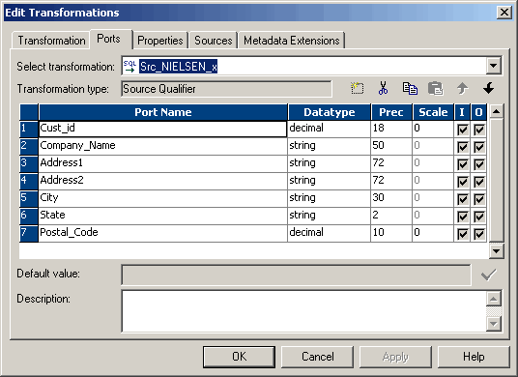
2.7: Source Qualifier Transformation
Introduction
Represents the source record set queried by the server
Mandatory in mappings using relational and flat file sources
Can be used to
  Define custom query, Join data, Source Filter, Number of sorted ports, Select Distinct
Figure 2.13
Notes:
The Source Qualifier displays the transformation datatypes. The transformation datatypes in the Source Qualifier determine how the source database binds data when the Integration service reads it. Do not alter the datatypes in the Source Qualifier. If the datatypes in the source definition and Source Qualifier do not match, the Designer marks the mapping invalid when saved. Source Qualifier can be used to perform following tasks:
Join data originating from the same source database - One can join two or more tables with primary-foreign key relationships by linking the sources to one Source Qualifier
Filter records when the Integration service reads source data - If a filter condition is included, the Integration service adds a WHERE clause to the default query
Specify an outer join rather than the default inner join - If a user-defined join is included, the Integration service replaces the join information specified by the metadata in the SQL query
Specify sorted ports - If a number for sorted ports are specified, the Integration service adds an ORDER BY clause to the default SQL query
Select only distinct values from the source - If Select Distinct is chosen, the Integration service adds a SELECT DISTINCT statement to the default SQL query
Create a custom query to issue a special SELECT statement for the Integration service to read source data

Slide 22
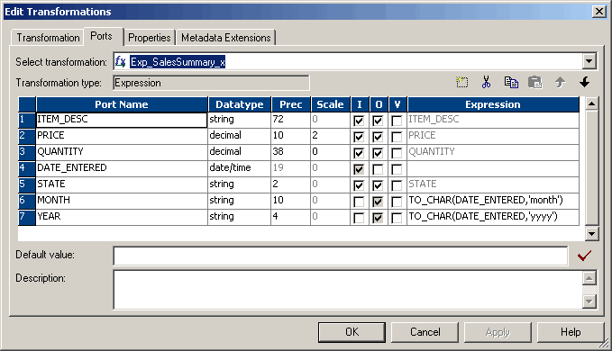
2.8: Expression Transformation
Introduction
Used to perform non-aggregate calculations
Expression statement is entered in an output port
Can enter only one expression for each output port
Expression Statement
Figure 2.14
Notes:
The Expression Transformation is used to calculate values in a single row. For example, in order to adjust employee salaries, concatenate first and last names, or convert strings to numbers. Use the Expression transformation to perform any non-aggregate calculations.

Slide 23
Demo
Notes:
The first step in the process of moving data between sources and targets is to create a mapping in the Mapping Designer.
Steps to create a mapping:
Open the Mapping Designer.
Choose Mappings | Create menu option, or drag a repository object into the workspace.
Enter a name for the new mapping and click OK. The naming convention for mappings is m_MappingName, such as m_demo
Steps to create a Source Qualifier Transformation:
Drag the required source, which can be a flat file or relational table in the mapping area, by default the Source Qualifier Transformation will be created for the source definition.

Slide 24
2.9: Aggregator Transformation
Introduction
Used to perform aggregate operations like sum, max etc.
Active Transformation
Have to group by values
Aggregate expression is entered in an output port
Notes:
The Aggregator Transformation allows to perform aggregate calculations, such as average and sum.
To configure ports in the Aggregator Transformation we can:
Enter an aggregate expression in any output port, using conditional clauses or non-aggregate functions in the port
Create multiple aggregate output ports
Configure any input, input/output, output, or variable port as a group by port, and use non-aggregate expressions in the port
Improve performance by connecting only the necessary input/output ports to subsequent transformations, reducing the size of the data cache
Use variable ports for local variables

Slide 25
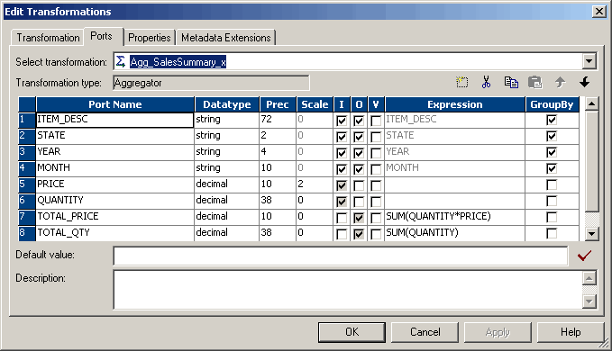
Aggregator Transformation
Aggregation Statement
Figure 2.15
Notes:
Components of the Aggregator Transformation
The Aggregator is an active Transformation, changing the number of rows in the data flow. It must be connected to the data flow. The Aggregator Transformation has the following components and options:
Aggregate expression - Entered in an output port. Can include non-aggregate expressions and conditional clauses
Group by port - Indicates how to create groups.
Sorted input - Is used to improve session performance. To use this option, the data passed to the Aggregator Transformation sorted by Group by port in ascending or descending order
Aggregate Cache - The Integration service stores data in the aggregate cache until it completes aggregate calculations. It stores group values in an index cache and row data in the data cache.

Slide 26
Sorted Input
You can improve Aggregator transformation performance by using the sorted input option.
When you use sorted input, the Integration Service assumes all data is sorted by group and it performs aggregate calculations as it reads rows for a group.
When necessary, it stores group information in memory.
To use the Sorted Input option, you must pass sorted data to the Aggregator transformation

Slide 27
Sorted Input
Used to decrease the use of aggregate caches since the Integration Service assumes all data is sorted by group.
As the Integration Service reads rows for a group, it performs aggregate calculations and stores group information in memory.
When using sorted inputs, pass sorted data through the Aggregator.
The Sorted Input option reduces the amount of data cached during the session and improves performance.
Contd
Notes:
Ex: for calculating sum of salaries department wise, if data comes in random order, Integration service needs to use cache for holding data until all the entries for a particular department is calculated (deptno 10,20....).
By using sorted input, Integration service does not use cache and just performs calculations assuming the data comes in sorter order thus improvement in performance.

Slide 28
2.9: Aggregator Transformation
Aggregate Cache
The aggregator stores data in the aggregate cache until it completes aggregate calculations.
When you run a session that uses an aggregator transformation, the Integration Service creates index and data caches in memory to process the transformation.
Index cache contains group values and data cache consists of row values.
Contd

Slide 29
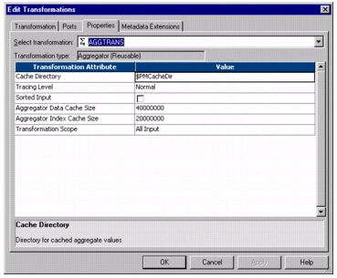
2.9: Aggregator Transformation
Aggregate Cache
Figure 2.16

Slide 30
Demo
Notes:
To create an Aggregator Transformation:
In the Mapping Designer, choose Transformation | Create menu option. Select the Aggregator Transformation. The naming convention for Aggregator Transformations is AGG_TransformationName.
Enter a description for the transformation.
Enter a name for the Aggregator, click Create. Then click Done. The Designer creates the Aggregator Transformation.
4. Drag the desired ports to the Aggregator Transformation. The Designer creates input/output ports for each port included.
5. Double-click the title bar of the transformation to open the Edit Transformations dialog box.
6. Select the Ports tab.
7. Click the group by option for each column the Aggregator should use to create groups.
8. If a non-aggregate expression to modify groups has to be used, click the Add button and enter a name and data type for the port. Make the port an output port by clearing Input (I).

Slide 31
Summary
After completing this lesson you now:
  Know about the PowerCenter Designer Component
  Know how to create source definitions
  Know how to create target definitions
  What is a mapping
  What is a transformation
  Know how to create a mapping

Slide 32
Review Question
Question 1: An __________ transformation changes the number of rows passing through it
Question 2: The Designer has five modes ___, ___, ___, ___, and ___
Question 3: An expression statement can be entered in an input port
  True
  False
Question 4: Connected transformations can be seen as a part of the mapping data flow
  True
  False

